Slide 1
Analytical Case:
PINETHASE Sales launch strategy
2025

Slide 2
Congratulations on advancing to Round 2!
Welcome to the Round 2 case!
At Qral Group we pride ourselves on the following key skills:
Communication Skills
All our consultants work with clients immediately upon joining and must be able to convey complex information in an engaging, professional manner.
Analytical Capabilities
We often work with large data sets and need to deal with ambiguity. This type of work may be new to you, but we value effort at problem-solving and critical thinking.
Resourcefulness
We spend time doing desk research, asking professional questions, and trying to find answers in unique ways.
We expect this case will take you 4-5 hours. We will invite 2-3 team members to listen to your final presentation of ~20 minutes and review the case results. Please feel free to reach out to us with any questions before your final presentation.

Slide 3
Agenda for Round 2 case presentation
Time | Topic
5 minutes | Introduction (candidate & Qral team members)
40 minutes | Candidate presentation and Q&A
15 minutes | Get to know you
TOTAL SCHEDULED | 60 minutes

Slide 4
Our client is launching a new product in the US, Pinethase
Current Situation
Situation
Our client is a mid-sized biotechnology company currently operating in the Oncology therapeutic area, launching a new molecule called Pinethase. Pinethase will be indicated for locally advanced or metastatic pancreatic cancer.
The client’s current portfolio consists of one Oncology product for rare lymphomas (launched in 2005), one Oncology product for metastatic cervical cancer (launched 2019), and one Oncology product for HER2+ metastatic breast cancer (launched 2020)
The client is expecting to get FDA approval for Pinethase in about 6 months
Market Overview
Mature, inadequate (3-4 key products), highly genericized (70%+)
Typical patient profile is elderly (65+), fragile, and has multiple comorbidities (and many prescription therapies)
Market research suggests that primarily Medical Oncologists and Radiation Oncologists operate in the locally advanced or metastatic pancreatic cancer market
Our Task
Make a recommendation on how our client should shape their US sales force for their new product, Pinethase

Slide 5
Questions to guide your thinking
Using the accompanying data set to support your recommendations (.xslx), please answer the following questions:
How many physicians should the client’s sales team target? How would you prioritize these physicians based on potential?
How many sales representatives would be required to service the list in question 1?
Beyond sales representatives, what other functions would you recommend that the client add?
Based on your answer in question 2, how would you divide up the country into equal opportunity territories? Show an example.
Bonus:
What other analyses would you want to do to ensure rigor? What other curiosities would you want to investigate?

Slide 6
Appendix

Slide 7
Anticipated Product Profile: Pinethase
Indication | The treatment of adult patients with locally advanced or metastatic pancreatic cancer who have previously received a chemotherapy and/or a platinum-containing chemotherapy in the neoadjuvant/adjuvant, locally advanced or metastatic setting.
Dosing & administration | For intravenous use only. Once weekly infusion.
Product concept | Antibody-drug conjugate for locally advanced or metastatic pancreatic cancer patients Specifically, this is the only medical therapy that has proven to reduce pancreatic cancer in a locally advanced or metastatic setting
Efficacy | Pinethase delivered a complete response in 12% (n=15/125) of patients and a partial response in 32% (n=40/125) of patients in clinical trials Pinethase achieved a clinically meaningful response in patients
Safety | Concomitant use with CYP3A4 inhibitors is not advised and may increase the incidence of Pinethase toxicities

Slide 8
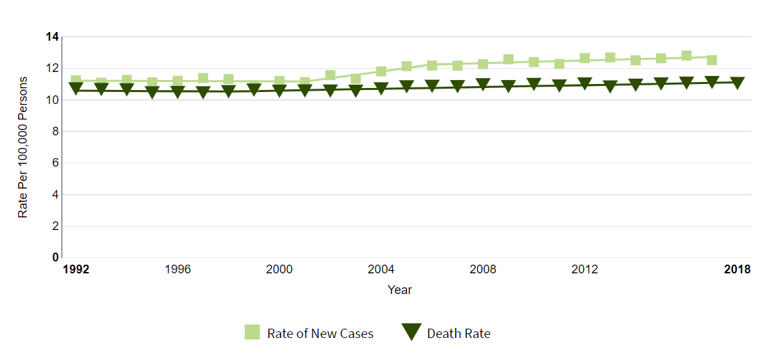
Estimated US incidence of pancreatic cancer
Epidemiology overview
Source: https://seer.cancer.gov/statfacts/html/pancreas.html

Slide 9
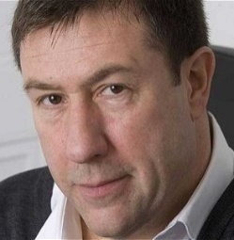
Medical Oncologist-Focused Journey
Pancreatic Cancer
The constant fatigue and nausea make it really hard for me to enjoy time with my family. Is there another way we can treat it?
Fever and fatigue have become constant and patient is bedridden.
Physician refers patient to a Medical Oncologist who runs tests. Finds bile flow being blocked and detects mass in pancreas via CT scan.
Lewis, CTA Driver
Age 60
Follow up visit with Medical Oncologist shows that the cancer spread is still increasing slowly.
Patient endures 7 weeks of gemcitabine chemotherapy
Jaundice begins to occur. Patient decides to go to an urgent care clinic.
Patient Symptoms
At clinic, physician performs physical exam and finds mass in abdomen.
Physician Visit
Abdominal pain is now accompanied by fever and fatigue.
Event
Medical Oncologist recommends another cycle of gemcitabine, this time combined with erlotinib.
During work one day, sudden abdominal pain and itching.
Biopsy taken at follow up appointment to confirm locally advanced Pancreatic Cancer diagnosis.

Slide 10
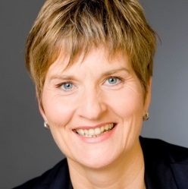
Radiation Oncologist-Focused Journey
Pancreatic cancer
I’m feeling strong with the chemo. How can we more aggressively treat this cancer?
In a follow up visit, physician does an MRI and ultrasound and detects mass in pancreas.
Patient continues to have abdominal pain, nausea, and vomiting.
Kathy, Accountant
Age 64
Patient sees a Radiation Oncologist to discuss radiation options
Patient endures 7 weeks of gemcitabine chemotherapy
Patient loses appetite for a couple days. Makes an appointment with Primary Healthcare Provider.
Patient Symptoms
At clinic, physician performs physical exam and finds swollen lymph nodes in the neck.
Physician Visit
Nausea and vomiting is now accompanied with abdominal pain.
Event
Patient undergoes radiation therapy.
During work one day, sudden nausea and vomiting.
Patient continues to go to follow ups with Radiation Oncologist.
Biopsy taken at follow up appointment to confirm metastatic Pancreatic Cancer diagnosis.

